Slide 1
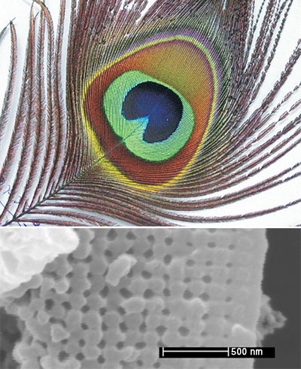
Photonic Crystals in Nature
Peacock feather
Morpho rhetenor butterfly
http://www.bugguy012002.com/MORPHIDAE.html
wing scale:
[ P. Vukosic et al., Proc. Roy. Soc: Bio. Sci. 266, 1403 (1999) ]
3µm
[J. Zi et al, Proc. Nat. Acad. Sci. USA,
100, 12576 (2003) ]
[figs: Blau, Physics Today 57, 18 (2004)]
[ also: B. Gralak et al., Opt. Express 9, 567 (2001) ]

Slide 4
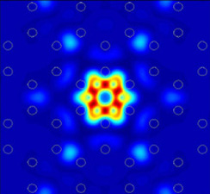

Slide 5
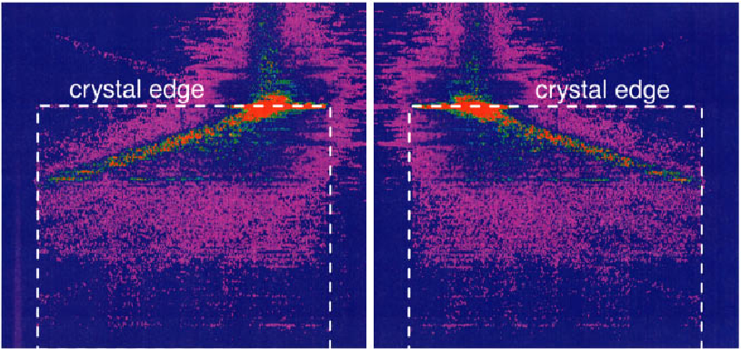
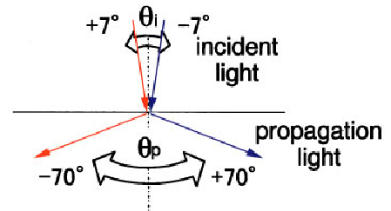
Superprisms
from divergent dispersion (band curvature)
[Kosaka, PRB 58, R10096 (1998).]

Slide 6
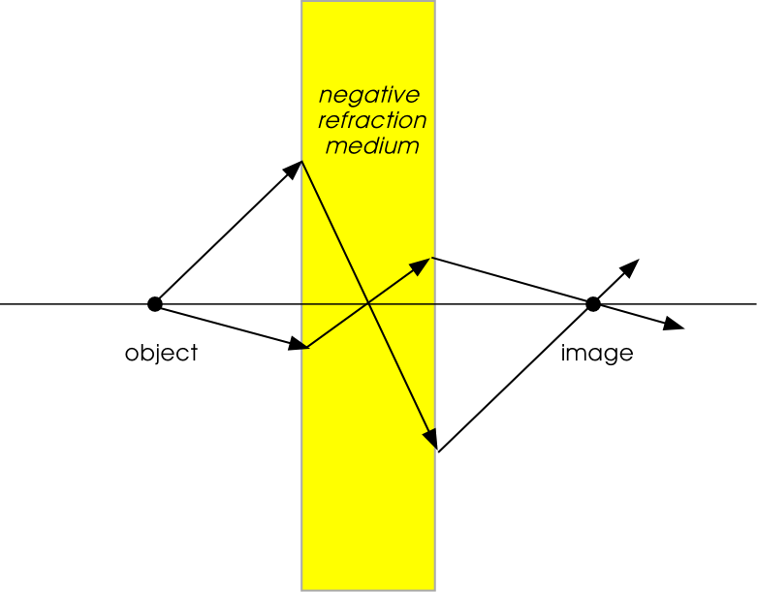
Negative Refraction
[ Veselago, 1968
negative ε, μ ]
opposite of ordinary lens:
only images close objects
does not require
curved lens
can exceed classical
diffraction limit

Slide 7
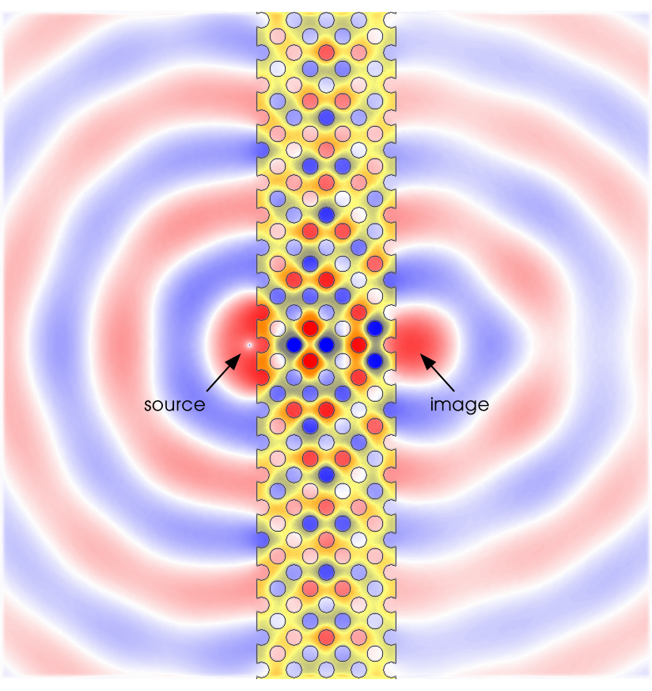
Superlens
[ Luo et al, PRB 68, 045115 (2003). ]
Here, using positive effective index but negative “effective mass”…

Slide 8
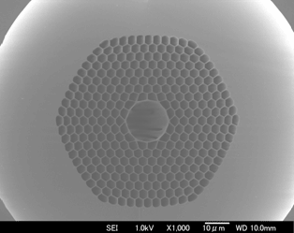
Crystal Fiber

Slide 9
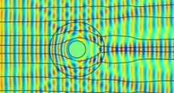
Optical Cloaking

